Slide 1
Elevator
Algorithm
201533673 최준헌
201835462 박해원
201835476 유근혁

Slide 2
Main idea
Feature
Progress
Timeline
INDEX

Slide 3
1. Main idea
“To reduce the waiting time for elevator”

Slide 4
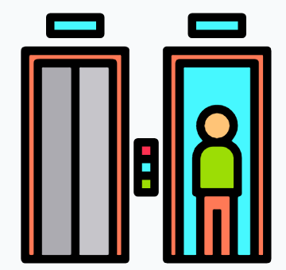
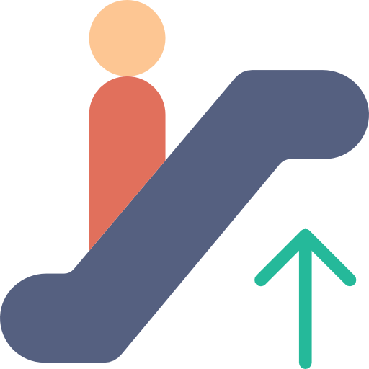
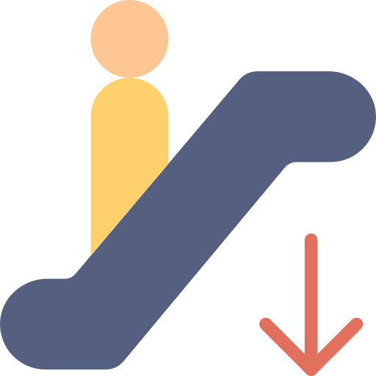
2. Feature
Main Function
Do.
3 elevator iterate with constant distance.
Each floor has one set of button for calling elevator.
Then.
Reduces overall waiting time by making elevator always move both downward and upward.

Slide 5
2. Feature
Main Function
UP Door
DOWN Door

Slide 6
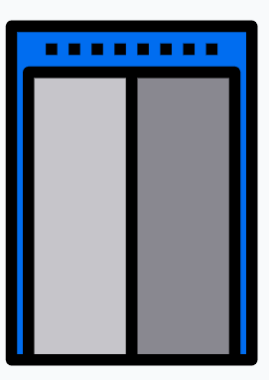
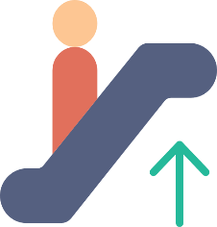
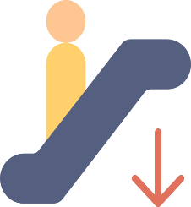
2. Feature
Main Function
Do.
If you press the button on the floor where you want to go the button, on each floor outside not inside the elevator, the time of arrival will be shown.
Then.
Let people know the approximate arrival time.
UP Door
DOWN Door

Slide 7



2. Feature
Main Function
1층
2층
3층
7층까지 20초 소요 예정 입니다!
4층
5층
6층
7층
8층
UP Door
DOWN Door
# 1층

Slide 8
3. Progress
Algorithm
Completion.
Main Algorithm & Time measurement
Additional requirements
Capacity overflow
Priority Scheduling
Connect Algorithm and UI
Debugging

Slide 9
3. Progress
UI
Completion.
- Implementing a frame to play elevator animation
- Implementing elevator buttons
Additional requirements
Implementing elevator animation
Connect to Button Event Network

Slide 10
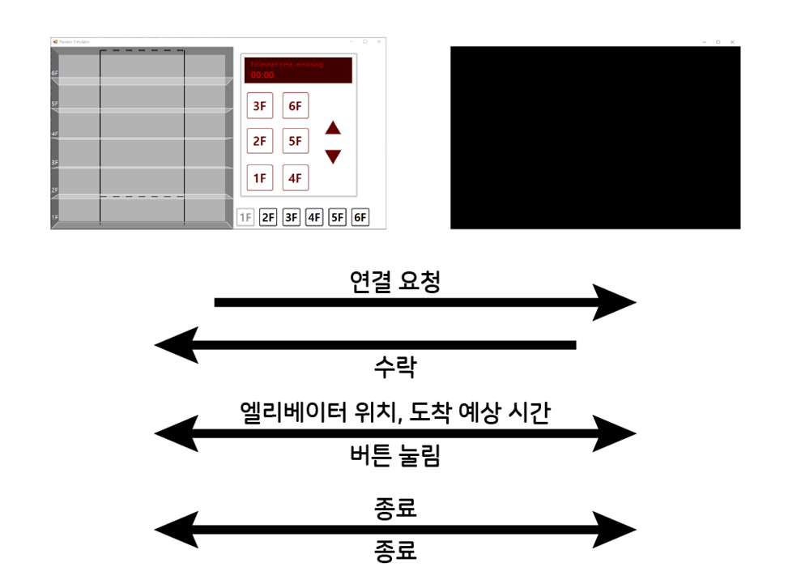
3. Progress
UI
Connection request
Finish
location, scheduled arrival time
Press Button
Accept
Finish
CLIENT
SERVER

Slide 11
3. Progress
UI
CLIENT
SERVER
Server receives button events from the client and uses them as parameters for the algorithm.

Slide 12
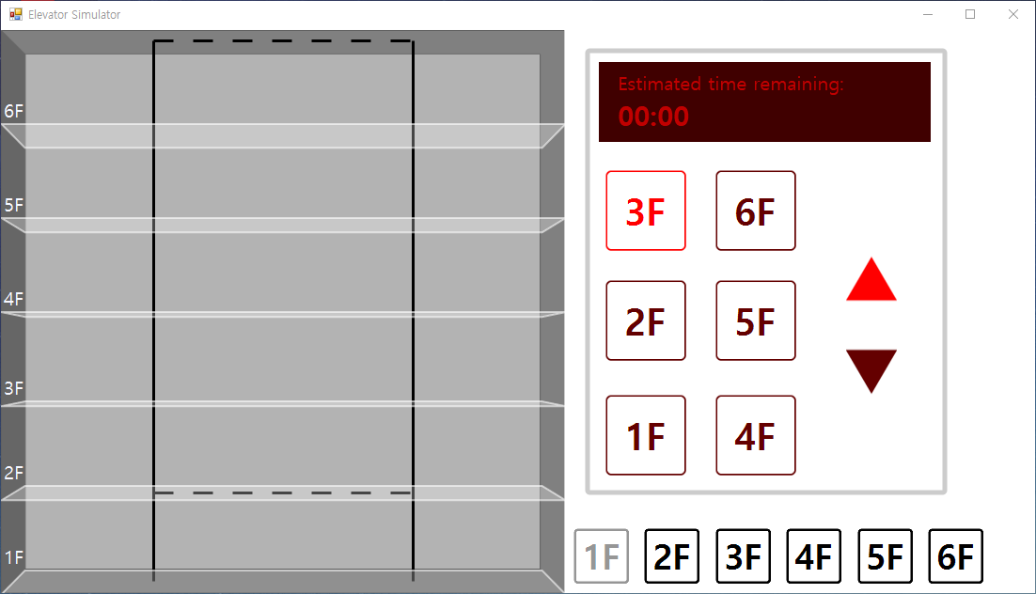
3. Progress
frame to play elevator animation
Screen Time measurement
Button that presses the desired number of floors
Current Number of floors

Slide 13
3. Progress
UI Additional requirements

Slide 14
4. Timeline
일 | 월 | 화 | 수 | 목 | 금 | 토
17 | 18 | 19 | 20 | 21 | 22 | 23
Main algorithm design |  | 중간발표 | Edtional function design
24 | 25 | 26 | 27 | 28 | 29 | 30
Debugging |  |  | apply feedback & upgrade & final confirm
1 | 2 | 3
Final PPT |  | 최종 발표

Slide 15
THANK
YOU

